Slide 1
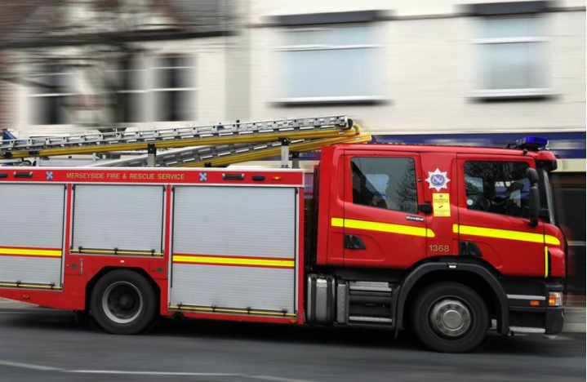
Employee Survey
Jan 2021
REMOVE

Slide 2
Our experience includes working with….

Slide 3
Response rate and changes since the last survey
61%
637 Online responses
211 of respondents did not take part in the last survey
524 did not feel the pandemic heavily influenced their response
FRS average: 50 - 55%
5 Points above previous (10 pts above 2016)

Slide 4
What is our Engagement score?
The Engagement score is 88%, which is excellent when
compared with the norms for Merseyside Fire & Rescue
2018
Items comprising the Engagement score
Question
Response favourability
2018
I am proud to say I work for MFRA
90%
96%
8%2%
3%1%
+11
I care about the future of MFRA
+7
I would still like to be working at MFRA in
two years' time
84%
81%
88%
11%5%
13%7%
9%3%
+10
88%
If asked, I would recommend to friends
and family that MFRA is a good place to
work
+21
12
Working here makes me want to do the
best I can
+13
Favourable
Neutral
Unfavourable
Your score
Merseyside Fire & Rescue 2018 norm

Slide 5
Our engagement score
2016
2018
2020
2014
Competitive Disadvantage
Competitive Advantage
Significant
disadvantage
Some disadvantage
Average (mean)
Some
advantage
Significant advantage

Slide 6
Engagement spread by function/place of work

Slide 7
What are our Theme scores?
Consistent upward trend across themes
Themes
Response favourability
2018
Goal Clarity
86%
80%
10%
+7
4%
8%
15%
14%
8%
My Job
12%
+13
+13
Employee Involvement
Teamwork
70%
68%
15%
18%
+26
Learning & Development
Recognition & Reward
Management Effectiveness
Culture & Values
76%
15%
+10
67%
68%
70%
20%
20%
13%
12%
11%
15%
+9
+13
+13
19%
Change Management
Health and Wellbeing
COVID-19 Related Questions
Engagement
58%
27%
+12
79%
86%
88%
15%
26%
7%
6%
9% 4%
+3
9%
n/a
+12
Yes/No Questions
74%
n/a

Slide 8
What is driving our Engagement score?
Key drivers
These 5 items have the strongest relationship with Engagement. Improvements in these are likely to have the biggest impact.
2018
+16 I feel valued
62%
86%
71%
68%
77%
+11
I get a sense of personal accomplishment from my work
2018
+13 I feel supported in my role
Engagement
+12
+33 I have confidence in the future of MFRA
+9
I feel MFRA treats people fairly, regardless of ethnic background, gender (including trans..

Slide 9
Best compared to history
These 5 results are the strongest when compared with Merseyside Fire & Rescue 2018, 16 Jul 2018
Impact Question
Theme
Response favourability
Vs Previous
We are good at sharing ideas
to make things work better
Teamwork
79%
13%
8%
10%
11%
+41
+33
+22
I have confidence in the
future of MFRA
Management
Effectiveness
68%
21%
I have a sense of good job
security
My Job
76%
13%
I am able to strike the right
balance between my work
and home life
Culture &
Values
+21
+21
78%
12%
10%
If asked, I would recommend
to friends and family that
MFRA is a good place to
work
Engagement
81%
13%
7%
Favourable
Neutral
Unfavourable

Slide 10
Weakest compared to history
These 5 results are the weakest (or least strong) when compared with Merseyside Fire & Rescue 2018,
16 Jul 2018 – more positivity!
Impact Question
Theme
Response favourability
Vs Previous
In general I would say my
health is good
Health and
Wellbeing
90%
92%
7% 3%
5% 3%
+1
I am clear about what I am
expected to achieve in my
job
+2
Goal Clarity
My manager communicates
regularly about issues that
affect my work
Management
Effectiveness
+3
82%
13%
13%
5%
6%
I have received the training
and development I need to
do my job well and safely
Learning &
Development
+4
81%
I understand how the work I
do helps MFRA to achieve its
Mission & Aims
+5
Goal Clarity
92%
7% 1%
Favourable
Neutral
Unfavourable

Slide 11
What are our highest scoring questions?
These 5 items are the highest scoring in the survey
Impact Question
Theme
Response favourability
2018
I care about the future of
MFRA
Engagement
96%
93%
3%1%
4%3%
+7
The organisation has kept
me well informed and has
maintained effective
COVID-19
Related
n/a
communication during the
COVID-19 pandemic
Questions
I understand the priorities or
Missions & Aims of MFRA
Goal Clarity
93%
93%
5% 1%
6% 1%
+7
I have the knowledge and
skills I need to do my job
well
Learning &
Development
+8
I am aware of the Health and
Wellbeing support services
available through the
Yes/No
Questions
93%
7%
n/a
Occupational Health Team
Favourable
Neutral
Unfavourable

Slide 12
What are our lowest scoring questions?
These 5 items are the lowest scoring in the survey. All having improved
Impact Question
Theme
Response favourability
41%
2018
A lot is done to help staff
prepare for and cope with
change
Change
Management
+15
+17
38%
32%
21%
MFRA is a better place to
work than it was 3 years ago
Culture &
Values
42%
44%
48%
10%
I feel that MFRA consider the
impact on me and other
people when making
decisions
Change
Management
24%
+17
MFRA Members engage well
with staff at MFRA
Management
Effectiveness
45%
47%
35%
20%
21%
+19
+16
Senior managers do what
they say they are going to
do
Management
Effectiveness
32%
Favourable
Neutral
Unfavourable

Slide 13
Has there been an improvement in the way in which we are communicating information throughout the organisation?
Regular updates about COVID-19
Majority feel that communications have especially improved since COVID-19
Some felt that there was too much information communicated to staff initially, not all of it relevant to the staff it was reaching, but now it is felt that the level of communication is sufficient and beneficial
Regular, informative emails
Improvements in communications via the online Portal
Yes – 70%
No – 25%
Both – 5%

Slide 14
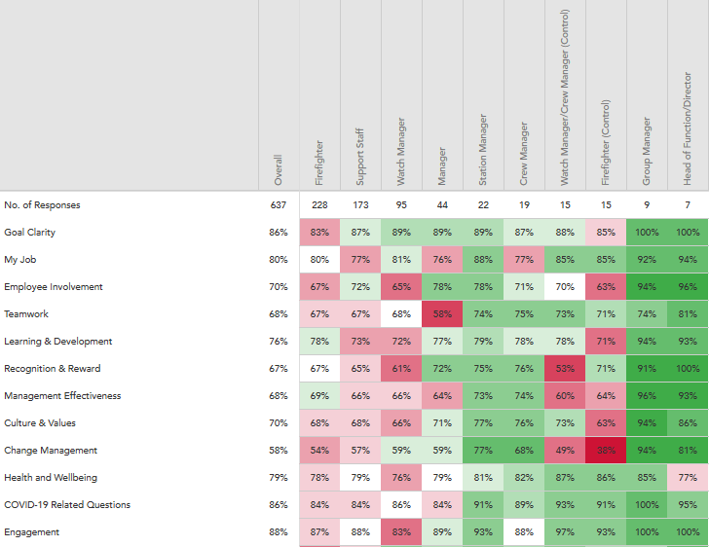
Variations across role/grade

Slide 15
What is the best thing?
What is the one thing to change?
Senior management – even more listening, more involvement in the department they manage, more accessible, transparent in communication
Work life balance – more flexibility in hours and location, more options to allow working from home
Career progression and development – fair and transparent promotion process, more opportunity for green book, more transparent opportunities
Reward and recognition – performance related pay, fair and consistent pay
Purpose – supportive colleagues, friendly, hardworking, dependable, working as a team
Serving communities and making a difference – helping people and communities when they most need it, sense of feeling as if you’re doing something good, meeting different people everyday
Working as part of a strong and close-knit team
Learning and development – continued learning, opportunities to train and grow
Job security – job for life, stability, security during the pandemic

Slide 16
Recommended focus areas and next steps

Slide 17
Celebrate – where to begin!
A 88% engagement score surpasses the external benchmark and the 2018 score by over 10% point. Taking you within the Top Quartile benchmark. Next year benchmark comparator – Top Quartile?
Encouraging to see response rate grow by 5 points and even more encouraging to see 211 take part who didn’t do so last time. A number of those also reporting a positive impact they have seen since the last survey
No questions have declined since 2018 and hardly any notably lower than the external benchmark
Areas particularly addressed last year (change management, cross service collaboration, communication) have shown big improvements. Importantly, people felt this is not just down to the pandemic
90% and over feel MFRA are doing a good job in maintaining the service is provides during the pandemic and keeping staff informed and communicated to

Slide 18
Three focus areas
Leverage your strengths
Continue to strengthen staff-management connection
Localised actions

Slide 19
Thank you and questions

