Slide 1

Employee Survey 2023
Executive insight presentation
Prepared by People Insight
March 2023

Slide 2








































Who we are

Slide 3
Contents
Headline messages
Employee engagement scores in detail
Highs and lows, comments
Focus areas
Hotspots
Summary and next steps
Survey response rate
32%
317 / 999
responses
vs.61% in 2020

Slide 4
Headline messages
Areas for focus
Low response rate
Notable drop in worklife balance question
Opportunities to better collaborate
Consideration of how change is managed
Notable hotspots by demographics (Control, Crew Manager, Protection etc.)
Strong employee engagement score and Top Quartile position retained
All themes scoring higher than the Fire and Rescue external benchmark (no question has scored lower than the benchmark)
Good confidence in the future of the Merseyside FRA
Staff feeling recognised and valued as well as useful appraisal
Strong alignment to the values, understanding of the direction and personal connection to it
Good communication channels/opportunities between leaders and staff

Slide 5
Since the last survey – changes that have ‘impacted you positively’
Leadership message has been necessary refresh and is much more comprehensive to teach/promote to others.
Consideration for improved flexible working and hybrid working
Empowerment in Decision Making for Senior Managers
Clear open communication from the Leadership team
Culture of openness ,communication and staff networks
The promotion of good, competent officers into senior positions
Updated vision and values of the service.
Flexibility of shift patterns

Slide 6
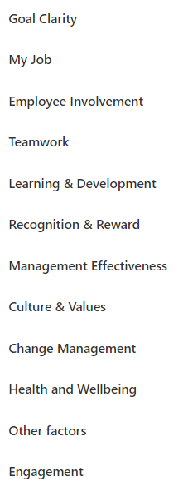
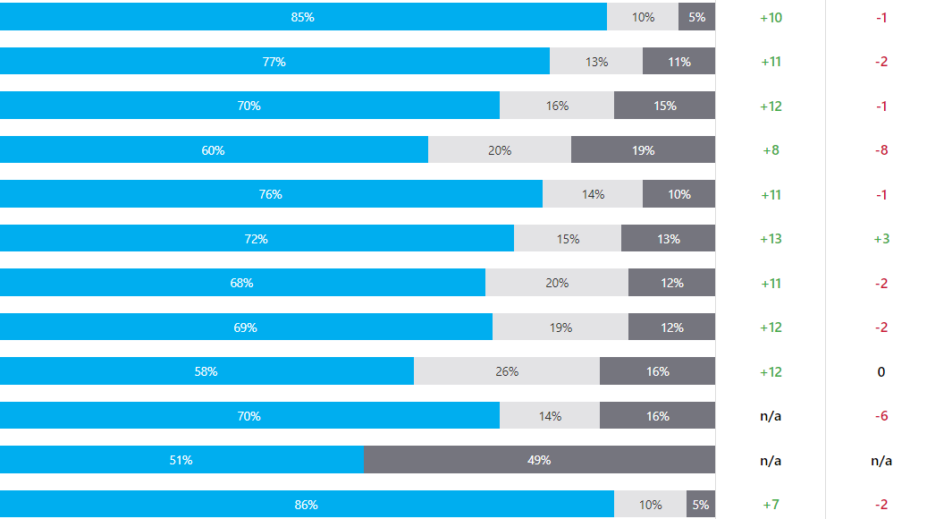
Survey themes
THEME | RESPONSE BREAKDOWN ( favourable  neutral  unfavourable) | Vs. FRS bmk | Vs. 2020
Themes remaining strong
Scores over performing against the Fire and Rescue benchmark
Themes primarily in line to the previous survey
Two notable drops (Teamwork and Health and Wellbeing)

Slide 7
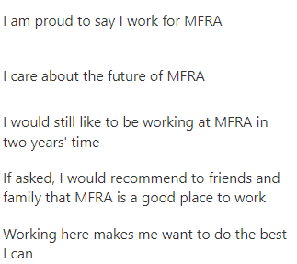
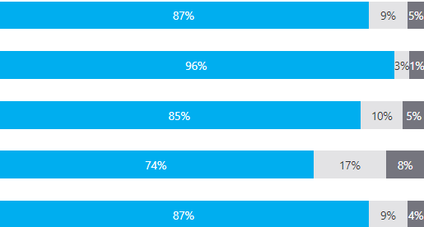


Engagement levels – remaining strong following previous improvement
QUESTION | RESPONSE BREAKDOWN ( favourable  neutral  unfavourable) | FRS bmk | VS. 2020
-2
+7
vs. 2020
vs. FRS bmk

Slide 8
Our engagement score
Compared to other organisations surveyed by People Insight
2018
Significant disadvantage
2022
Some disadvantage
2016
Average (mean)
Some advantage
2020
Significant advantage
2014
Engagement range by Function
Competitive
Disadvantage
Competitive
Advantage

Slide 9
Top and bottom scores
Highest Scoring
QUESTION | RESPONSE BREAKDOWN ( favourable  neutral  unfavourable) | VS. FRS Bmk | Vs. 2020
I am aware of the Health and Wellbeing support services available through the Occupational Health Team |  | n/a | +3
I understand how the work I do helps MFRA to achieve its Purpose |  | +14 | +3
I know what I should do and what action I should take if I was concerned that bullying and harassment were taking place |  | n/a | n/a
I understand the need for change at MFRA so the Service remains relevant and continues to meet the needs of our communities |  | +9 | +11
I am clear about what I am expected to achieve in my job |  | +6 | -2
Lowest Scoring
QUESTION | RESPONSE BREAKDOWN ( favourable  neutral  unfavourable) | VS. FRS Bmk | Vs. 2020
Members of the Fire and Rescue Authority engage well with staff at MFRS |  | n/a | n/a
A lot is done to help staff prepare for and cope with change |  | +6 | +1
MFRA is a better place to work than it was 3 years ago |  | n/a | 0
I feel that MFRA consider the impact on me and other people when making decisions |  | +10 | 0
Change here is well managed overall |  | +16 | -8

Slide 10
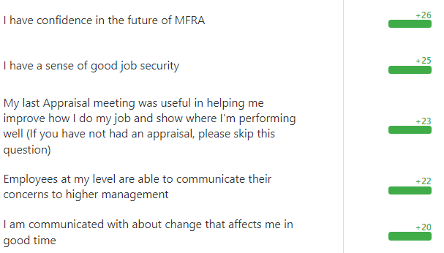
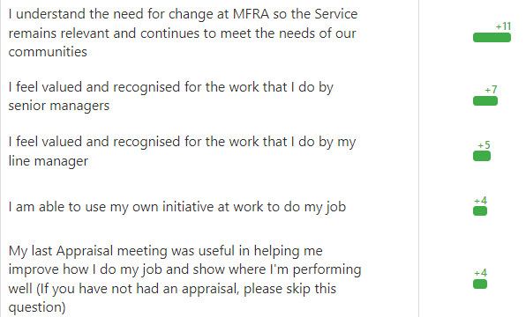
Most positive comparisons
+ difference scoring
QUESTION | Vs. FRS Bmk
QUESTION | Vs. 2020

Slide 11
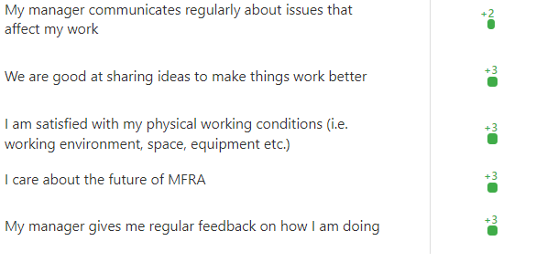
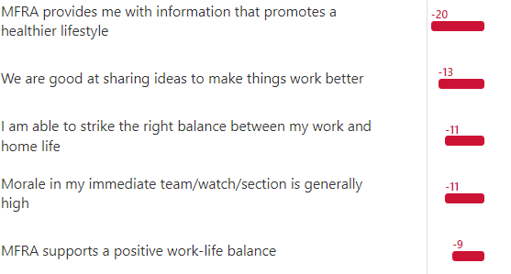
Least positive comparisons
- difference scoring
QUESTION | Vs. FRS Bmk
QUESTION | Vs. 2020

Slide 12
Qualitative feedback themes – best thing
the people, the flexi, serving the community, introduction of hybrid working for support staff in 2023
I feel supported by Senior and Principal management who I feel appreciate the work that I do for the Authority. Most people are positive about working for MFRA which makes a good, enjoyable working environment.
The variety within the role. Every day is different and provides me with challenges
My team and my line manager support me in my role and I get good satisfaction from completing my duties

Slide 13
Qualitative feedback themes – one thing to change
More opportunity for green book development as progression is often limited due to line management roles largely being grey book in some department.
Introduce hybrid working for green book or grey book day staff where applicable to match other areas of the public sector post pandemic
Non-salary incentives that mitigate comparatively low pay such as free tunnel fees, free business insurance if expected to drive personal car for work, dental/ healthcare schemes. Childcare schemes.
More active involvement, communication and listening from middle management, to match that from our senior leadership

Slide 14
Demographic Hotspots

Slide 15
Other demographic hotspots
Gender scores primarily aligned across most questions with near to none notable differences.
Those with a disability responding notably less favourably across all themes.
Not enough respondents from different ethnicity groups in order to note any observations
‘5-10’ years length of service responding less favourably than other service lengths. ‘Employee involvement’ in particular lower (60% vs. 70% overall)

Slide 16
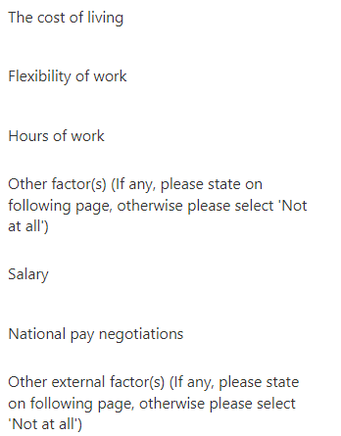
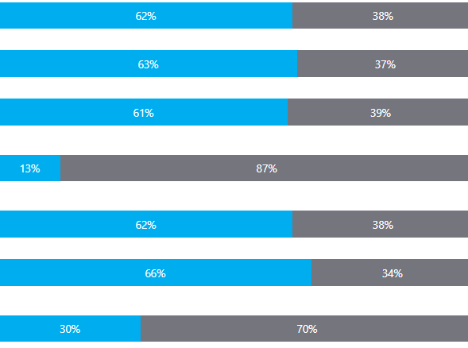
Factors effecting how people respond
Factor | RESPONSE BREAKDOWN ( Significantly or Moderately  Not all or Slightly)
Overall, Uniformed and Non-uniformed staff responded similarly
Hours of work and Flexibility impacting how Non-Uniformed responded much more than Uniformed. AND National pay negotiations impacting uniformed responses notably more.
Of all Functions Prevention responded most highly in terms of being impacted by these factors when responding.

Slide 17
Summary and
Next Steps

Slide 18
Leverage and celebrate strengths
Don’t forget the good
We are quick to go on to the ‘reds’ and forget how ‘green the grass is’
Strong engagement score retained
‘External’ factors will throw negativity your way and at your staff. Do your best to celebrate and share successes
Focusing on strengths will help drive engagement just as much (or more) as focusing on the negatives
Share with staff (already in scope)

Slide 19
Suggested actions and next steps
The process of change
Change often does not please people so some negativity is typical here. However:
  Explore ways people can have some involvement with upcoming change
  Continue to listen and respond before, during, and after the change. Check in with people to see if anything can be provided (in the realm of possible)
Work life balance
Exploration into the drop around worklife balance.
  What has changed over the years to create the notable difference?
  Do people feel less enabled to manage the balance in comparison to two years ago?
Getting granular
Keep to 2-3 actions at a high level
Ensure enablement at different levels to help with targeted and relevant action. Consider:
  By function
  By role
  By level

Slide 20
6 steps to success
Understand
Share
Prioritise
Plan
Act
Sustain
Seek first to understand
Leadership is a
contact sport
Start doing more
by doing less
A goal without a
plan is just a wish
The key to success
is action…
…the essential in action is perseverance
An incredible outcome in light of the national industrial climate and cost of living challenges faced by employees

Slide 21
Q&A

